Slide 1
SalesOutlook CRM
100% inside of Outlook and Exchange
Auto file emails and calendar meetings
Side Panel view in your Inbox
Extend Outlook into a groupware application
Account, Contacts, Opportunities, Leads, Customer Service, and custom modules.
Advanced and Simple customizations
Constant Contact and QuickBooks Integration
Excel Reports
Word and Excel Document management
Dashboard
Mobile Client
Web Client
Utilizes your Investment in Microsoft Office and or Office 365
Integrates with Microsoft Teams as a Dialer

Slide 2
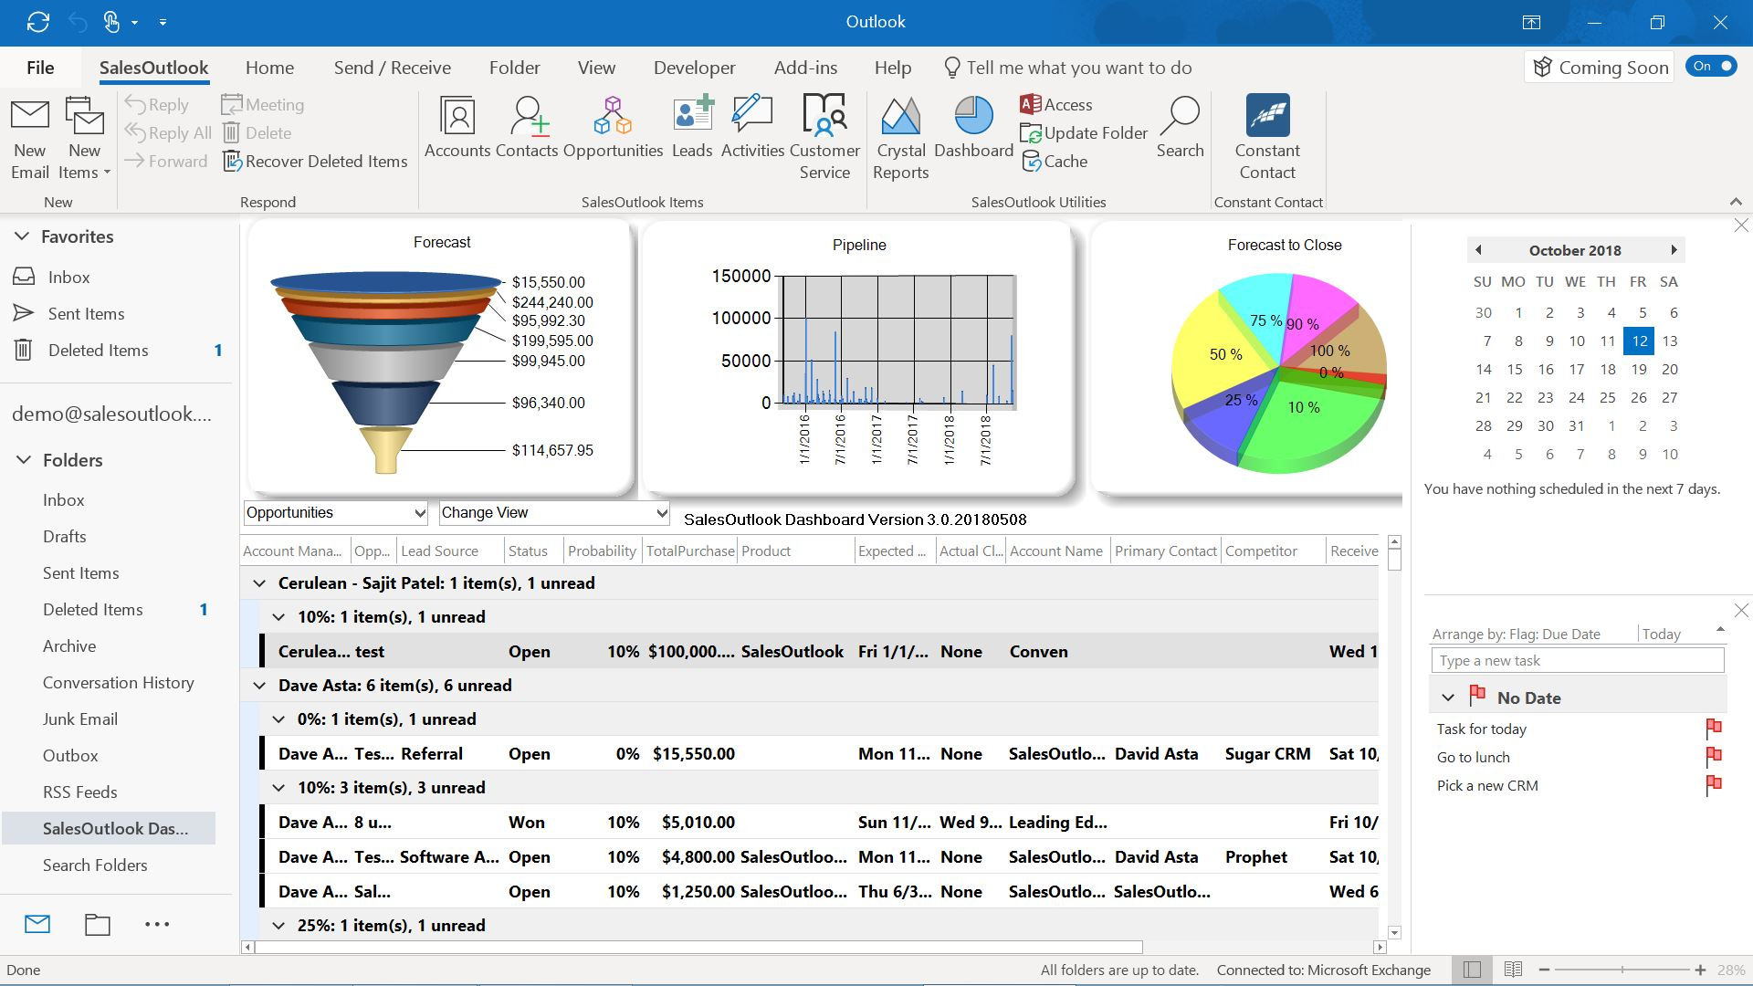
SalesOutlook DashBoard

Slide 3
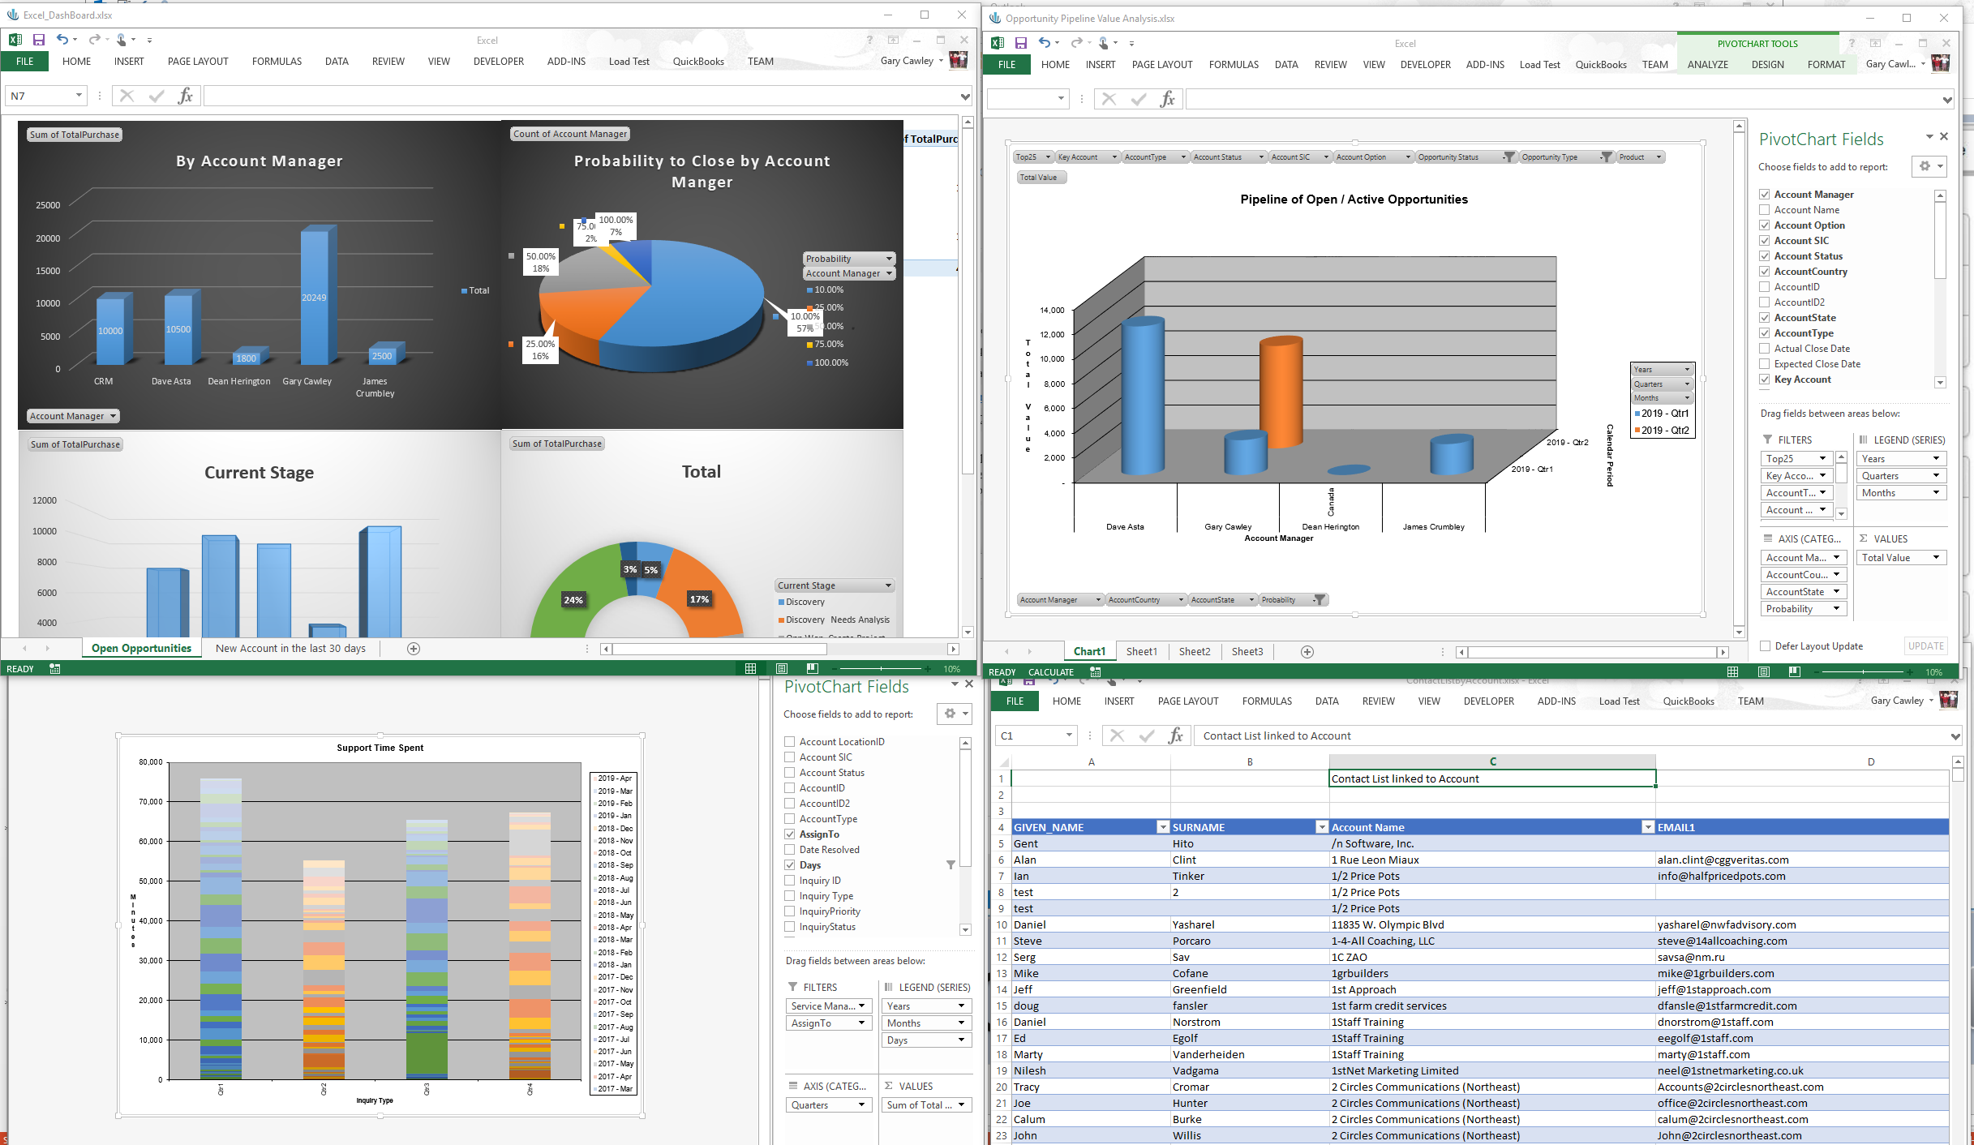
SalesOutlook Excel Reporting

Slide 4
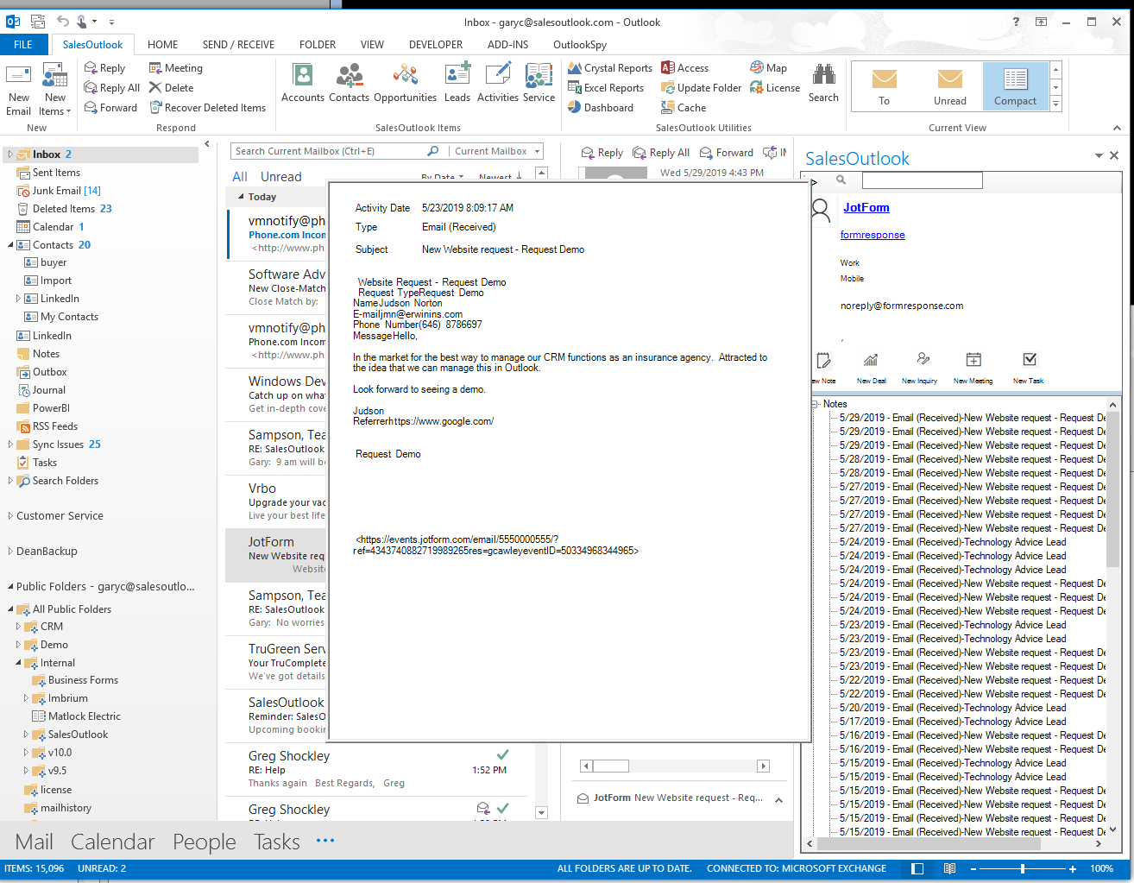
SalesOutlook Side Panel in your Inbox

Slide 5
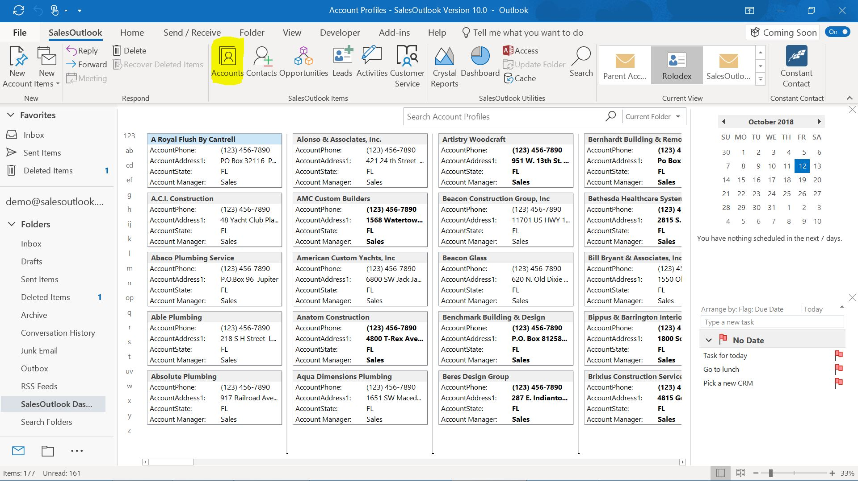
SalesOutlook is an extension to Outlook

Slide 6
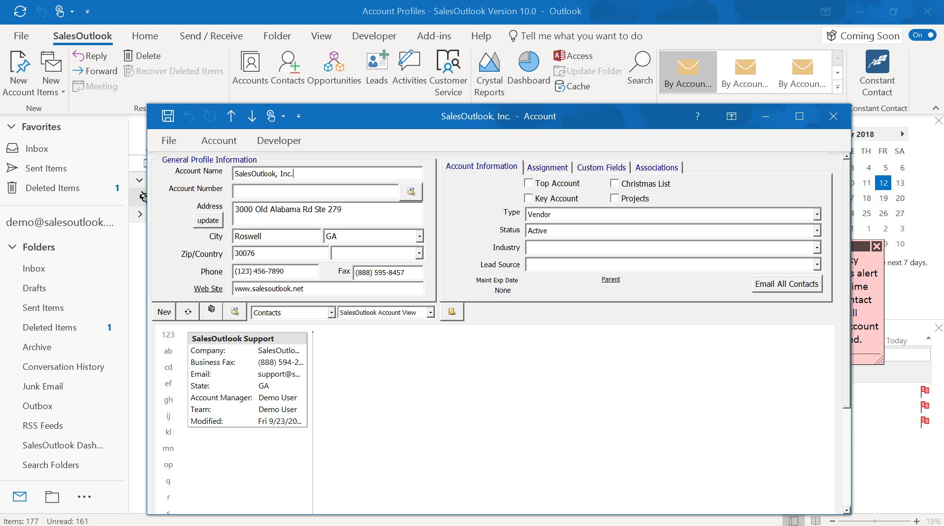
SalesOutlook Account Form

Slide 7
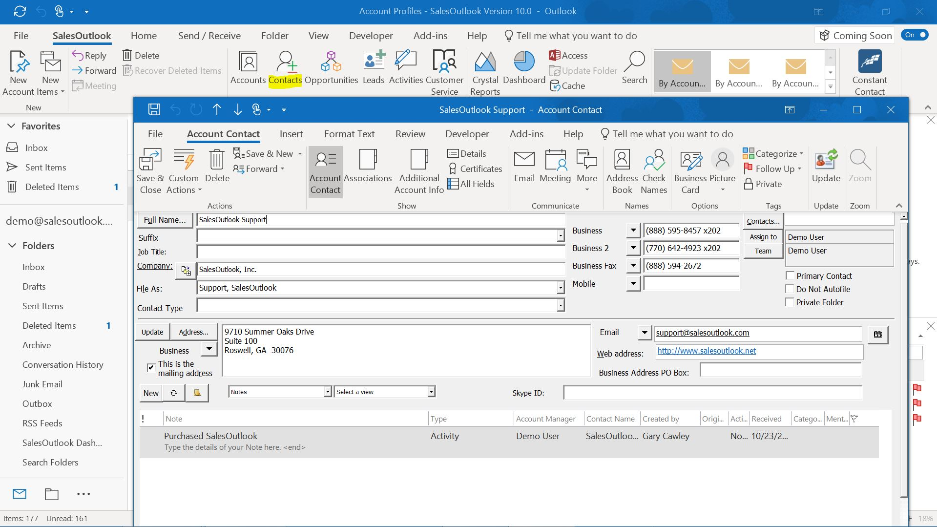
SalesOutlook Contact Form

Slide 8
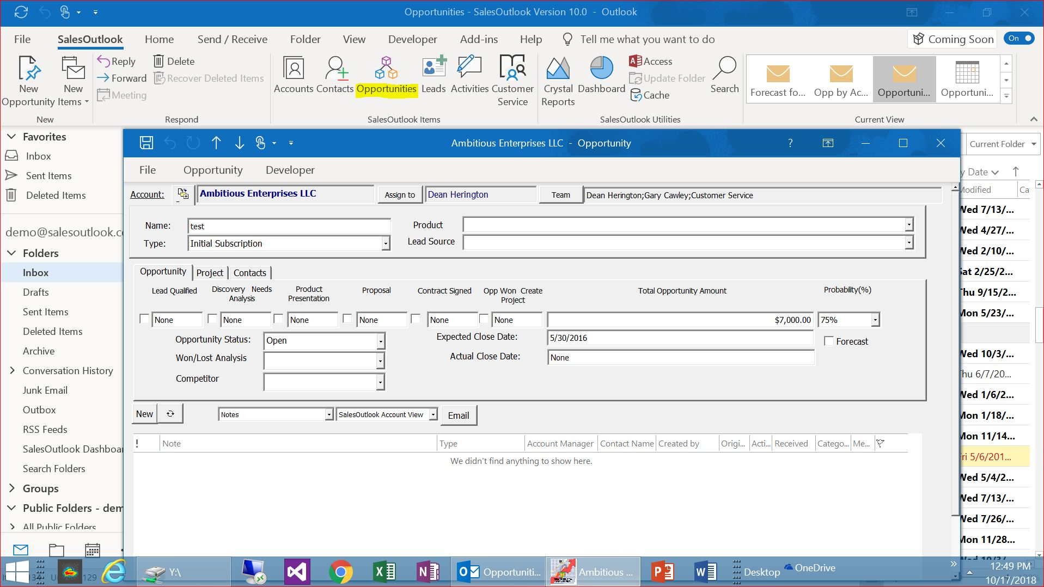
SalesOutlook Opportunity Form

Slide 9
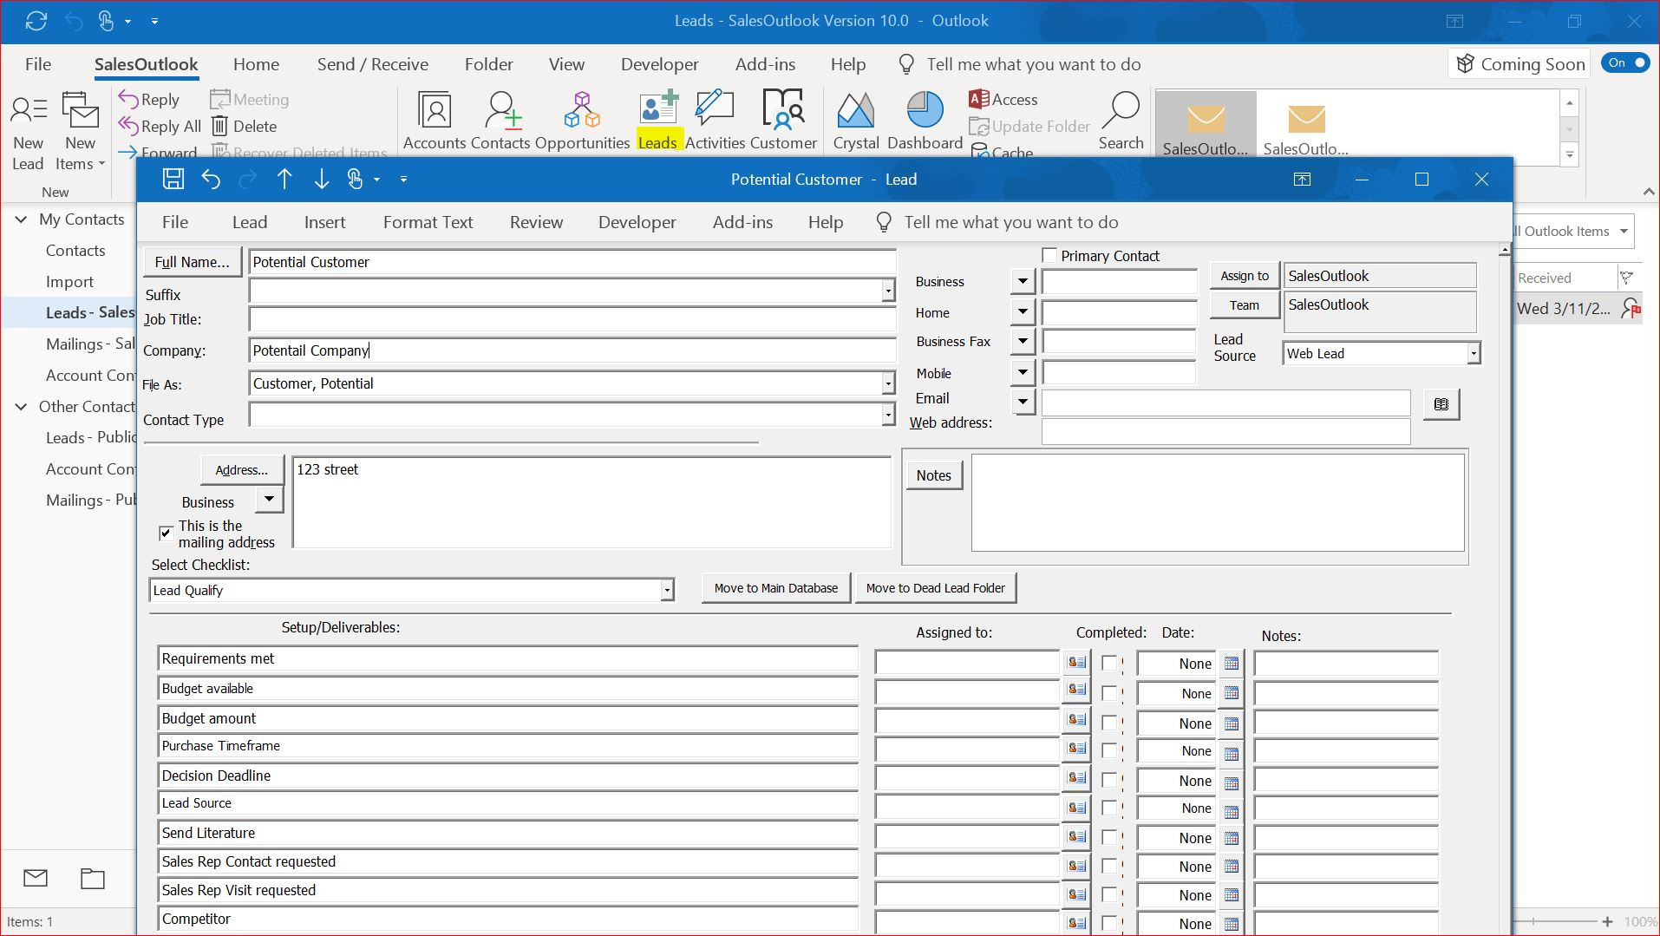
SalesOutlook Lead Form

Slide 10
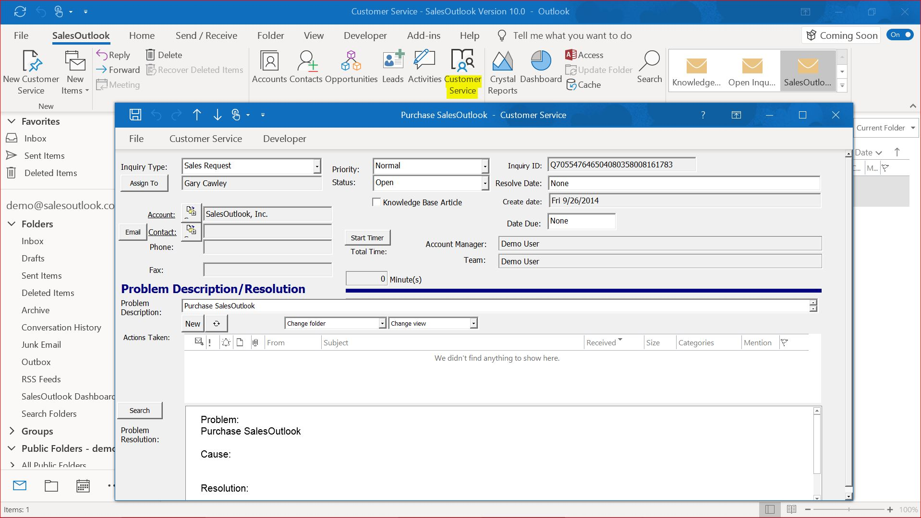
SalesOutlook Customer Service Form

Slide 11
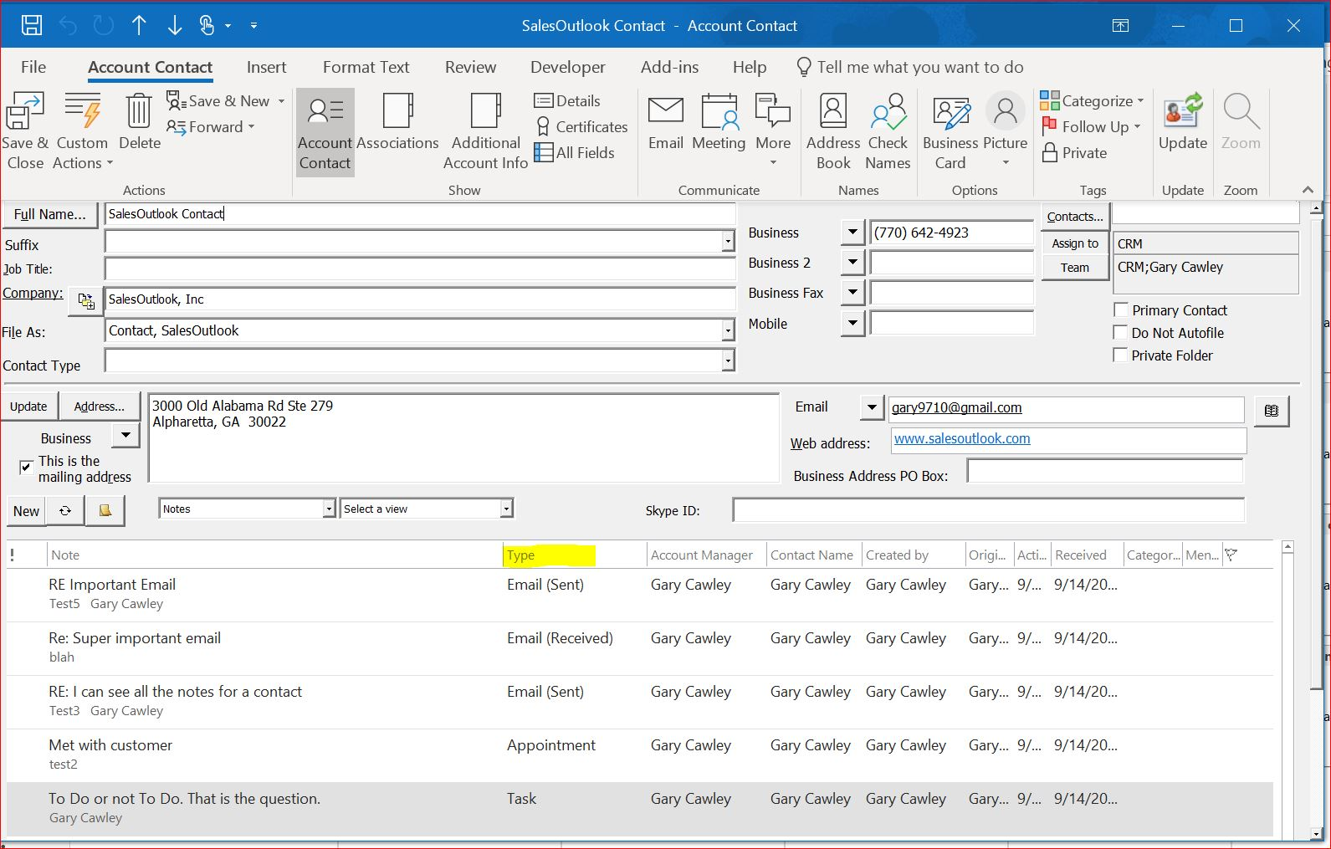
SalesOutlook Activity View

Slide 12
SalesOutlook Ribbon Toolbar provides Easy Access to all SalesOutlook Items

Slide 13
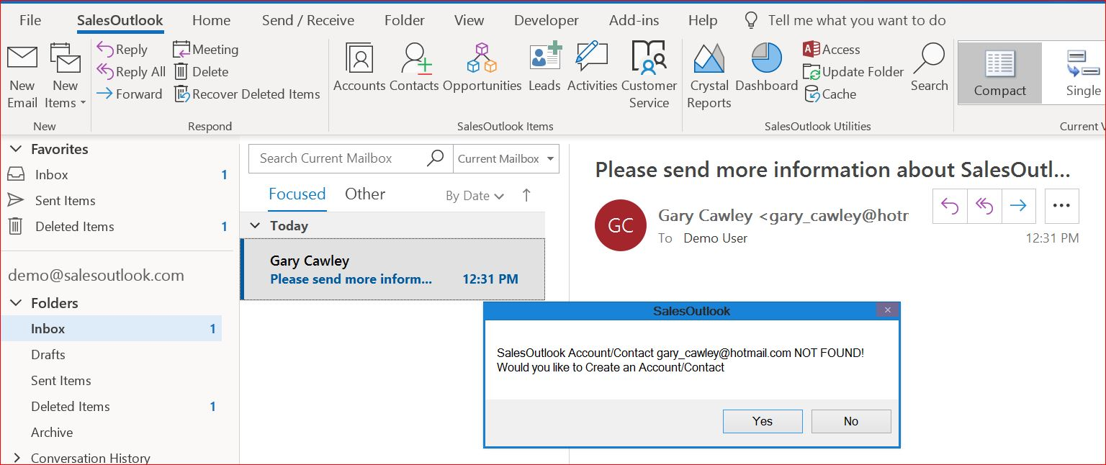
Create a Contact, Account, Opportunity or Customer Service Inquiry from an Email

Slide 14
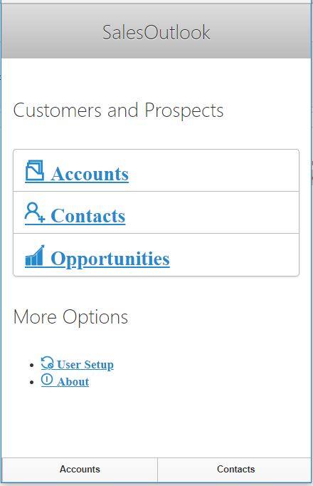
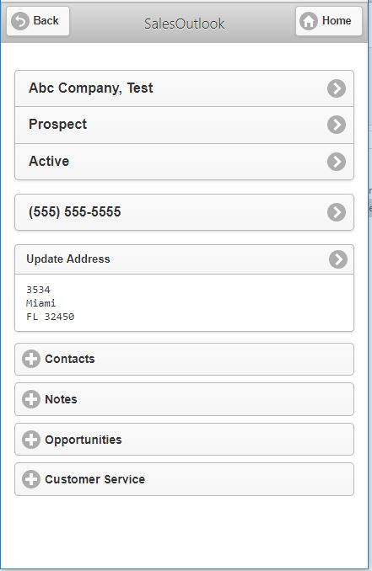
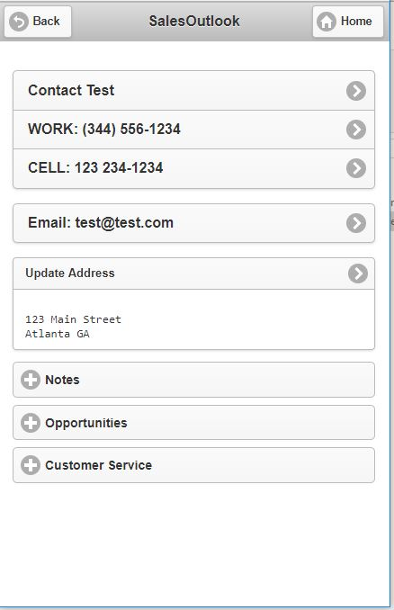
SalesOutlook Mobile

Slide 15
Automatically or Manually File Emails at the Account, Contact or Opportunity

Slide 16
Constant Contact Email Marketing Integration

Slide 17
SalesOutlook is a Smart Start for Your Business!

